Slide 1
EXCEPTION HANDLING

Slide 2
Objectives
Understand what are errors?
Understand why we use Exceptions?
Difference between structured and non-structured exception handling
What are Exception Objects
How to use try, catch and finally blocks
Multiple catch Blocks
Use throw keyword

Slide 3
Errors
Errors are part of any application, that we make knowingly or unknowingly. There are many types of errors that occur in our program, such as
Compile-time error:
Syntax errors: Design-time errors. Occurs due to incorrect syntaxes. Cannot be compiled and run. Such as, forgetting to place semi-colon (;) at the end of line.
Runtime-error:
Logical errors: Occurs during run-time. Difficult to track down. Occurs when desired output is not obtained. Such as, trying to calculate salary of an employee by adding different salary structure parameters, but forgot to include one of them and getting unexpected less amount rather than expected result.
System errors: Occurs when the program is compiled and run. Occurs because code is syntactically correct but cannot be executed due to some unexpected state of the computer. Such as, trying to access an element from an index position of an array where that index does not exist in that array.

Slide 4
What is an Exception?
Exception is not an error. Rather, Exception is an abnormal condition that arises due to system error while executing a program
In .NET an exception is an object that describes an exceptional condition (run-time system error) that has occurred when executing a program.
Effective exception handling will make your programs more robust and easier to debug. They help answer these three questions:
What went wrong?
Answered by the type of exception thrown.
Where did it go wrong?
Answered by exception stack trace.
Why did it go wrong?
Answered by exception message

Slide 5
How an Exception is handled?
Exception happens due to system’s failure to execute code because of an abnormal condition
For example, when you write a code to divide zero or some other value by zero and then try to execute, system will not be able to perform that job
CLR then creates an object to represent the unexpected error and then throws it to the method which caused it
That method may choose to handle the exception itself or pass it on
Either way, at some point, the exception is caught and processed
Sources for exceptions could be
Generated by CLR
Manually generated by programmer’s code.

Slide 6
Exception Hierarchy
The base class for all the exception related classes is Exception. Two child classes that inherit from it are SystemException and ApplicationException class.
Exception
SystemException
ApplicationException
Base class library exception classes
OutOfMemoryException
IOException
Custom exception class should extend this class
NullReferenceException
…………………………

Slide 7
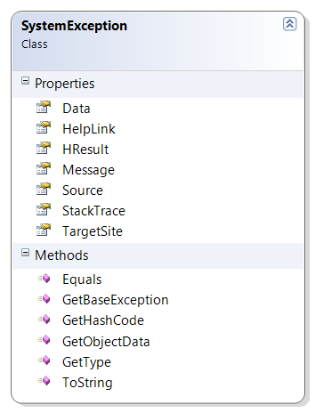
System.SystemException class
Defines the base class for predefined exceptions in the System namespace.
This class is provided as a means to differentiate between exceptions defined by the system versus exceptions defined by applications

Slide 8
Important Methods and Properties of Exception class
Message property: This property gets a message that describes the current exception. It returns the error message that explains the reason for the exception, or an empty string("").
Source Property: This property gets or sets the name of the application or the object that causes the error. It returns the name of the application or the object that causes the error.
TargetSite Property: Gets the method that throws the current exception. It returns the instance of MethodBase class, present in System.Reflection namespace, representing information of the method that threw the current exception
StackTrace Property: it gets a string representation of the frames on the call stack at the time the current exception was thrown. It returns a string that describes the contents of the call stack, with the most recent method call appearing first.

Slide 9
Exception handling constructs
Four constructs are used in exception handling:
try – a block surrounding program statements to monitor for exceptions
catch – together with try, catches specific kinds of exceptions and handles them in some way
finally – specifies any code that absolutely must be executed whether or not an exception occurs
throw – used to throw a specific exception from the program

Slide 10
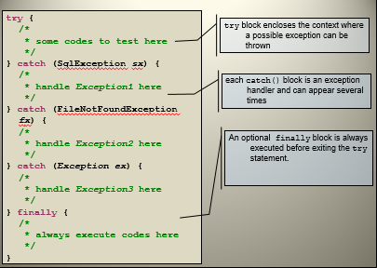
The try, catch and finally block

Slide 11
Using try and catch Blocks
Object-oriented solution to error handling
Put the normal code in a try block
Handle the exceptions in a separate catch block
try
{
int x=0; int y=0; int z;
z = x/y;
}
catch (DivideByzeroException caught)
{
Console.WriteLine(caught);
}
Program logic
Error handling

Slide 12
Multiple catch Blocks
Each catch block catches one class of exception
A try block can have one general catch block
try
{
Console.WriteLine("Enter first number");
int i = int.Parse(Console.ReadLine());
Console.WriteLine("Enter second number");
int j = int.Parse(Console.ReadLine());
int k = i / j;
}
catch (OverflowException caught) {…}
catch (DivideByZeroException caught) {…}

Slide 13
An important note about multiple catch block
A catch block which catches all exceptions (catch block accepting Exception class object) should be placed as the last one if you are using multiple catch blocks.
try
{
Console.WriteLine("Enter first number");
int i = int.Parse(Console.ReadLine());
Console.WriteLine("Enter second number");
int j = int.Parse(Console.ReadLine());
int k = i / j;
}
catch (OverflowException caught) {…}
catch (DivideByZeroException caught) {…}
catch (Exception caught) {…}
try
{
Console.WriteLine("Enter first number");
int i = int.Parse(Console.ReadLine());
Console.WriteLine("Enter second number");
int j = int.Parse(Console.ReadLine());
int k = i / j;
}
catch (Exception caught) {…}
catch (DivideByZeroException caught) {…}
catch (OverFlowException caught) {…}
Correct approach
Wrong approach

Slide 14
The finally Clause
All of the statements in a finally block are always executed
Monitor.Enter(x);
try
{
...
}
catch(Exception ex)
{
//code }
finally
{
Monitor.Exit(x);
}
Any catch blocks are optional. Try can be followed by either catch or finally
Finally blocks are mainly used to clean up resources, such as if you have opened database connection or file connection in try block then close them in finally block, because due to some exception if the following codes are not executed, they are bound to get executed at least in finally block

Slide 15
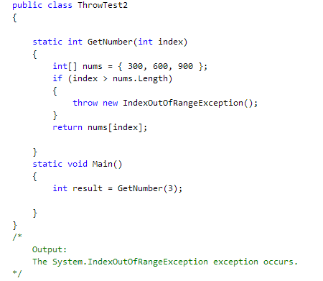
“throw” statement
the thrown exception is an object whose class is derived from System.Exception
Usually the throw statement is used with try-catch or try-finally statements. A throw statement can be used in a catch block to re-throw the exception that the catch block caught. In this case,
the throw statement does not take an exception operand

Slide 16
Why Use Exception?
Exception Handling: Traditional approach
Method returns error code.
Problem: Forget to check for error code
Failure notification may go undetected
Problem: Calling method may not be able to do anything about failure
Program must fail too and let its caller worry about it
Many method calls would need to be checked
Instead of programming for success object.doSomething() you would always be programming for failure: if (!object.doSomething()) return false;

Slide 17
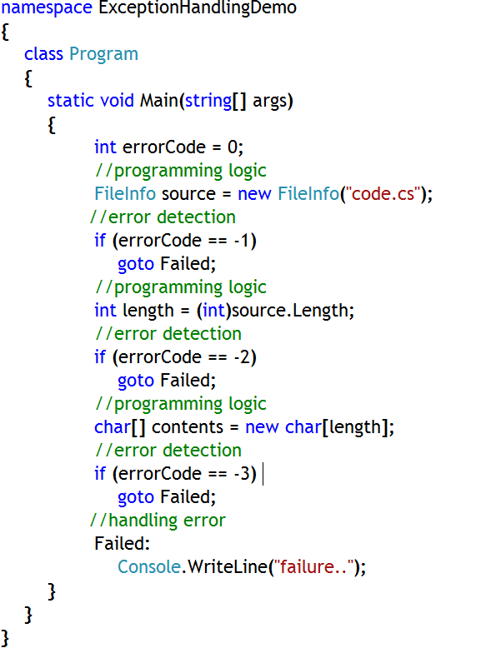
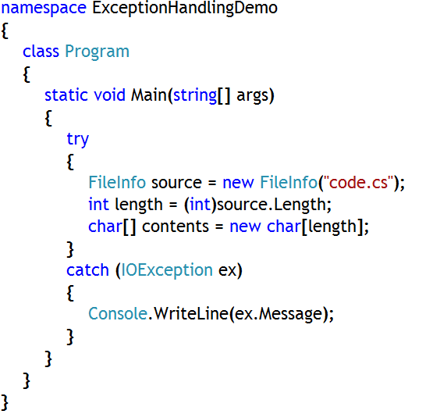
Why Use Exceptions?
Traditional Approach vs. Structured Exception Handling
Traditional procedural error handling is cumbersome. Actual code is not separate from exception code.
Structured Exception Handling makes it easy to separate exception code from actual code

Slide 18
Reference
For further details on Exception Handling Guidelines please refer this link
http://msdn.microsoft.com/en-us/library/ms229005(VS.80).aspx
http://www.codeproject.com/Articles/550510/Exception-Handling-and-NET
http://www.thecodekey.com/C_VB_Codes/Exception_Handling.aspx
Notes:
Reference

